Slide 1
Automatic Non-Taxonomic Relation Extraction from Big Data in Smart City
JING QIU, YUHAN CHAI, YAN LIU , ZHAOQUAN GU , SHUDONG LI , AND ZHIHONG TIAN
(Date of publication November 15, 2018, date of current version December 27, 2018, IEEE Access)

Slide 2
Research Area
Knowledge Extraction
Non-taxonomic relations
Semantic graph
Dependency relation (Dependency syntactic identification)

Slide 3
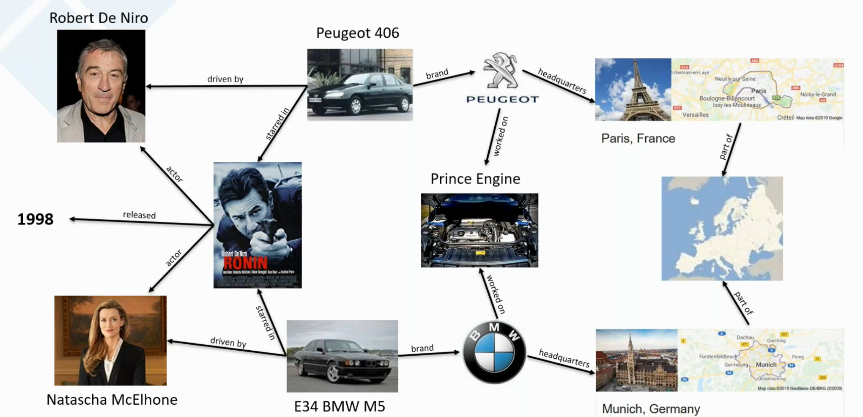
Knowledge Graph

Slide 4
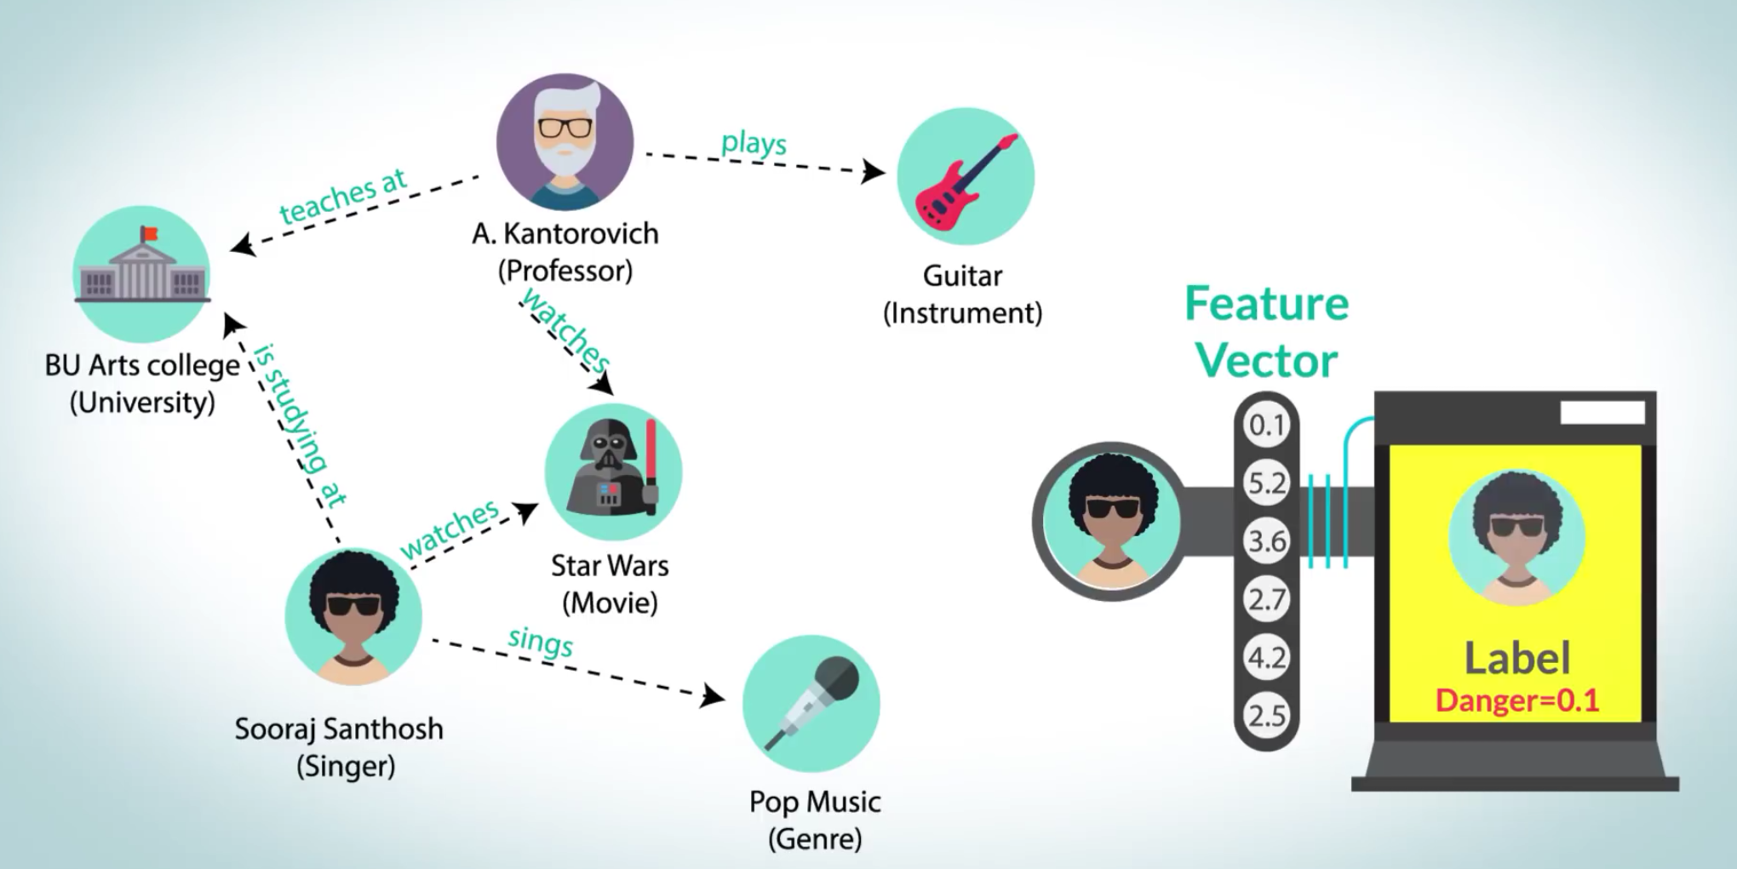
Decision from Knowledge Graph (1/2)

Slide 5
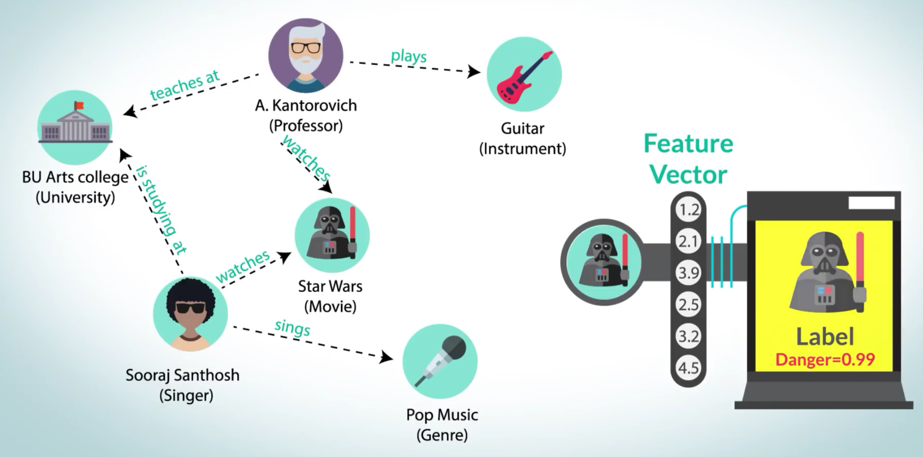
Decision from Knowledge Graph (2/2)

Slide 6
The Problem
Huge amount of data in smart city makes challenges for extracting useful information.
Major research works and applications are in Deep Learning and Knowledge Graph, involving subtask (most difficult!) in extracting non-taxonomic relationship.
Most research work have:
Limited practical applications
Neglected in syntactic and semantic information in relations that are extracted

Slide 7
Research Contribution
This research contributes to:
Extracting non-taxonomic relation at higher precision, based on combination of (i) semantic graph and (ii) context information.
Providing ‘better’ labels for relations that have been extracted from A, thanks to combination of (i) dependency syntactic information and (ii) statistical information

Slide 8
Approach
Step 1: Identify non-taxonomic relations
SGNRI (semantic graph based non-taxonomic relationships identification)
Step 2: Labelling non-taxonomic relations
Verb extraction
Statistical selection
LDA
Word2Vec
Syntactic dependency parsing

Slide 9
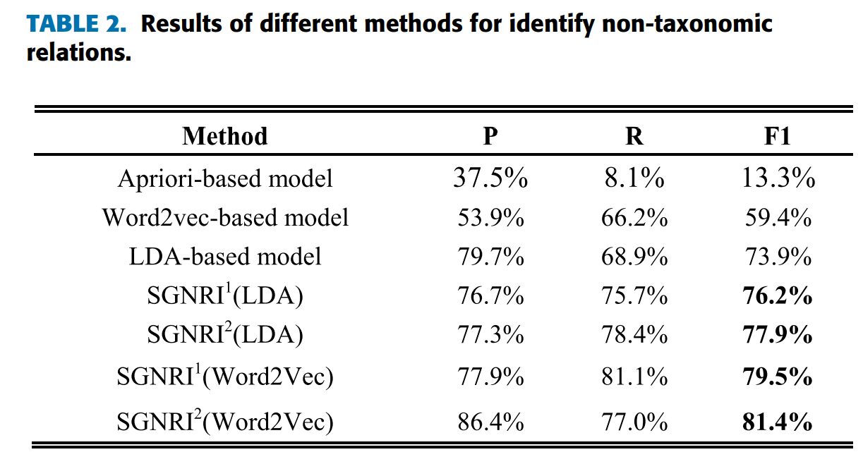
Result – Step 1

Slide 10
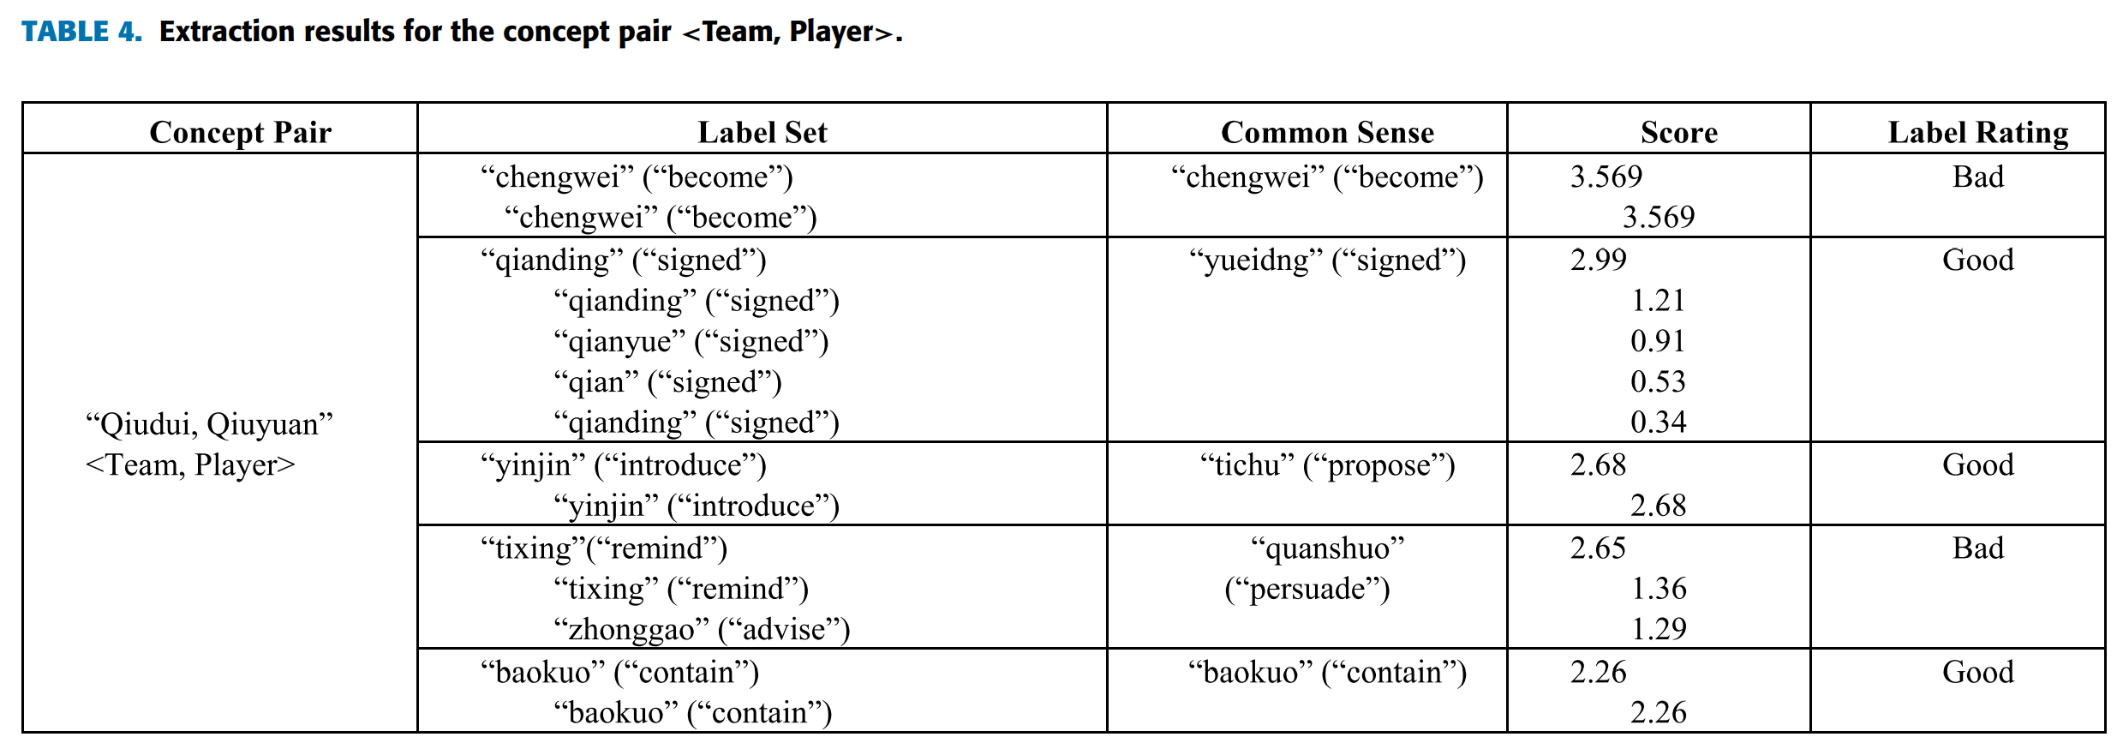
Result – Step 2
Each relation has top-5 verb candidate labels (total 370 = 74*5)
Domain experts rating ‘Good’/’Bad’ verb per relations

Slide 11
Future Works
Extracting good formal verb
Clustering verbs with same meaning
Considering information from multiple sources (e.g., sensing devices, multimedia data,…) – not only web sources as in this paper - can help to improve performance.

Slide 12


